Slide 1
18656 Final Project Demo
Faculty Advisor - Jia Zhang Team - Harsha Sanne,Hao Tang, Bowen Zhang, Xinyuan Chen,Tingfang Pan
Data Intensive Workflow Development for Software Engineers (18-656), Fall 2015

Slide 2
Roadmap
Introduction
Motivation
Related work
System design
System implementation
Challenges
Demo
Conclusions and future work

Slide 3

Introduction
It’s a data intensive software system for SOSE research community

Slide 4

Motivation
To understand and get insights of data is the current big challenge for almost every industry.

Slide 5

Graph Database
Relation database is not good choice to get insights especially data like research community which involves relations and networks.

Slide 6
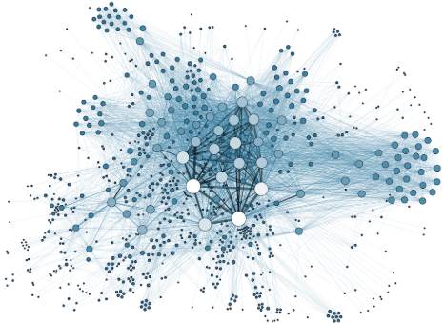
Data Insights
But this is not the complete solution.

Slide 7
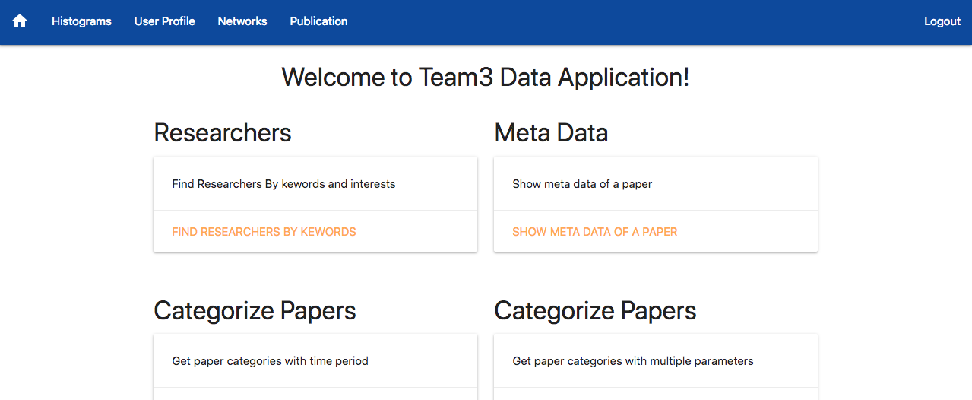
So that’s how we developed this application which collects, aggregates, classifies, analyzes and visualizes the data.

Slide 8



Related Work

Slide 9





System Design
Model
Model
API
Controller
Controller
cypher
View

Slide 10
DataBase Architecture
Keyword
CO_AUTHORS
HAS_KEYWORD
Author
SearchedKey
SEARCHED
WRITES
Follows
Paper
REFERS_TO

Slide 11
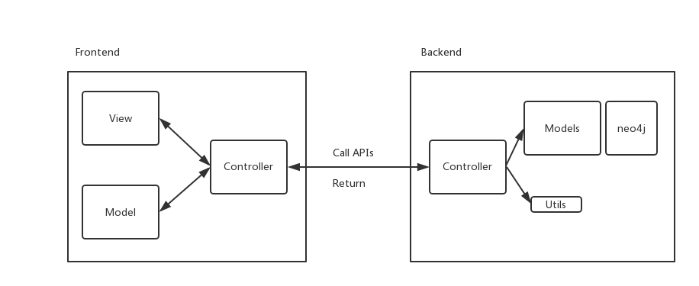
System Implementation
Frontend/ Backend MVC
RESTful APIs
Design Pattern
Singleton

Slide 12
Some Challenges with Complex Query
Some features require very complicated queries that can potentially impact performance. We tackle some of these challenges by creating additional relations to assist query optimization
Example: given two authors, find the shortest path between them.
There is no direct links between co-authors in the original data schema.
We create direct “Co-Author” relations between authors that have collaborations on some papers
We apply the built-in shortest path function to retrieve the degree of separation between two authors

Slide 13
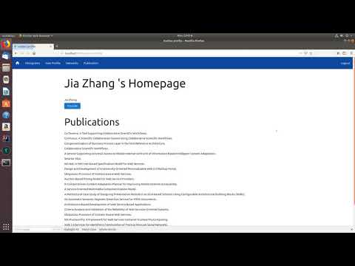
Demo
Login & Account Activities

Slide 14
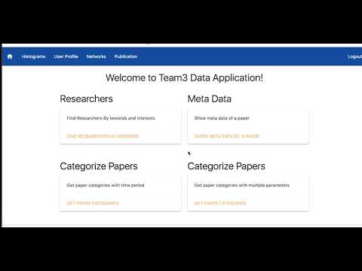
Demo
Account Activities continued

Slide 15
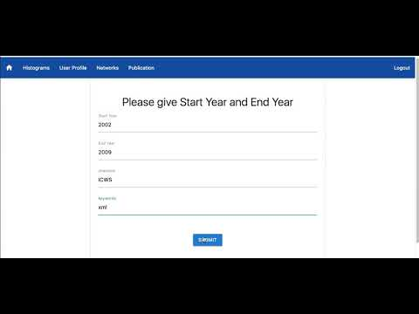
Demo
Paper Categorization

Slide 16
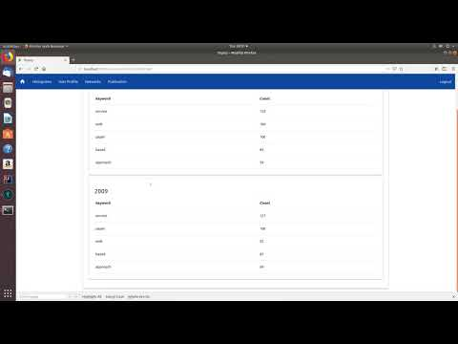
Demo
All kinds of Search

Slide 17
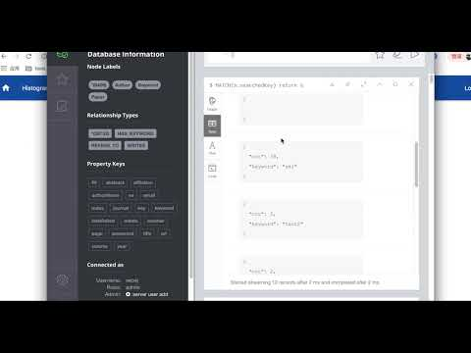
Demo
All kinds of Search, continued

Slide 18
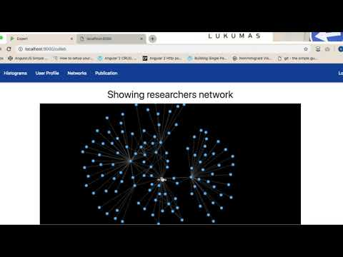
Demo
Top Citation & Author Network & Paper Network

Slide 19
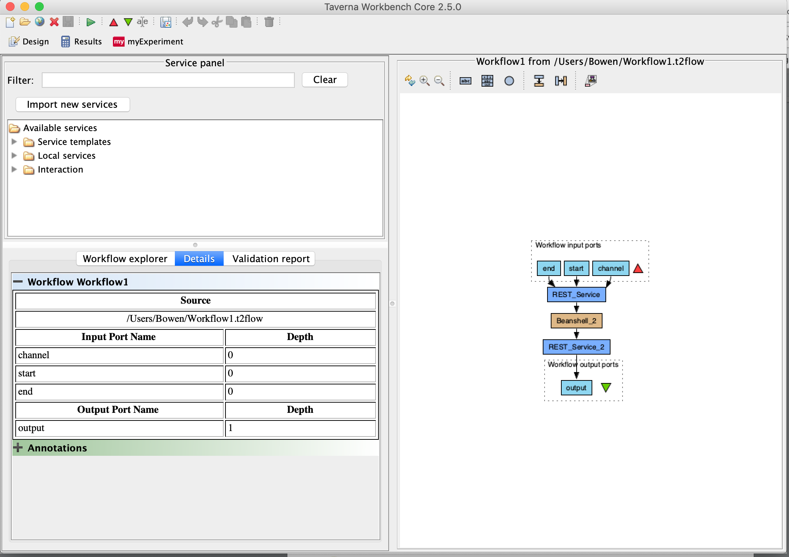
Demo
Workflow Integration

Slide 20
Future Work
Scalability Challenges
Some APIs require more complex query and therefore more compute power.When called frequently, it creates scalability issues
Solution: Decouple particular queries and turn them into independent micro services (Separate JVMs) away from the general “backend” JVM.
Read Performance
Since most of our operations are reads, we can use cache to improve read performance
Proposal: key-value pairs stored in LinkedHashMap

Slide 21
Future Work Continued...
Periodic Statistics Improvement
We don’t want to recompute the entire period every time it’s requested.
Pre-compute: background threads can be spun to periodically run and aggregate the results in memory
High Availability and Disaster Recoverability
The idea is to eliminate single point of failure by introducing redundancy into the system
Typical Architecture: load-balancing between multiple play servers so if one dies and system continues to function
A replica of the database in the event of disaster.

Slide 22

Questions?

